Slide 1

WEB TECHNOLOGIES
JavaScript –Built in Objects
Prof.Vinay Joshi and Dr.Sarasvathi V
Department of
Computer Science and Engineering

Slide 2

JavaScript – Built-in Objects
Global Objects supported
Math
Number
String
Array
Date
window
document
Notes:
Touch

Slide 3
JavaScript – Built-in Objects
Array
Arrays are lists of elements indexed by a numerical value starting with 0 to length - 1
Arrays can be created using
The new Array method
let arr = new Array(100) – creates an array of 100 elements
let arr = new Array(10, 20) – creates an array of 2 elements
Literal arrays using square brackets
var alist = [1, “ii”, “gamma”, “4”];
Notes:
Touch

Slide 4
JavaScript – Built-in Objects
Array Length
Array length property can be modified at runtime
Hence, the length property does not necessarily indicate the number of defined values in the array
const arr = [1, 2];
console.log(arr);
// [ 1, 2 ]
arr.length = 7; // set array length to 5 while currently 2.
console.log(arr);
// [ 1, 2, <5 empty items> ]
for (i in arr)
console.log(typeof i + i));
// string 0
// string 1
Notes:
Touch

Slide 5
JavaScript – Built-in Objects
Array
Array Elements Can Be Objects
JavaScript variables can be objects. Arrays are special kinds of objects. We can have objects in an Array. We can have functions in an Array. We can have arrays in an Array.
myArray[0] = Date.now; myArray[1] = myFunction; myArray[2] = myCars;
Notes:
Refer notes for details on all methods

Slide 6
JavaScript – Built-in Objects
Array Methods
push – Add to the end
pop – Remove from the end
shift – Remove from the front
unshift – Add to the front
join – return a string with array elements
indexOf – return the index of array
sort – sort an array in ascending order by default
concat – concatenate two arrays
slice – returns a subset if of the array
Notes:
Refer notes for details on all methods

Slide 7
JavaScript Basics
JavaScript Arrays - Methods
Adding Array Elements
Both methods adds a new element (Lemon) to fruits
var fruits = ["Banana", "Orange", "Apple", "Mango"];
fruits.push("Lemon");
Or
Fruits[fruits.length] = “Lemon”

Slide 8
JavaScript Basics
JavaScript Arrays method
1) Converting Arrays to Strings
const array1 = [1, 2, 'a', '1a’];
console.log(array1.toString()); // expected output: "1,2,a,1a"
2) The join() method also joins all array elements into a string.
const elements = ['Fire', 'Air', 'Water’];
console.log(elements.join());// expected output: "Fire,Air,Water“
3) Popping and Pushing
The pop() method removes the last element from an array:
var fruits = ["Banana", "Orange", "Apple", "Mango"]; fruits.pop();

Slide 9
JavaScript Basics
JavaScript Arrays - Methods
4) Shifting Elements
The shift() method removes the first array element and "shifts" all other elements to a lower index.
var fruits = ["Banana", "Orange", "Apple", "Mango"]; fruits.shift();
The unshift() method adds a new element to an array (at the beginning
var fruits = ["Banana", "Orange", "Apple", "Mango"]; fruits.unshift("Lemon"); // Adds a new element "Lemon" to fruits

Slide 10
JavaScript Basics
JavaScript Arrays - Methods
5) Deleting Elements
var fruits = ["Banana", "Orange", "Apple", "Mango"];
delete fruits[0]; // Changes the first element in fruits to undefined
6) Splicing an Array
The splice() method changes the contents of an array by removing or replacing existing elements and/or adding new elements in place
var fruits = ["Banana", "Orange", "Apple", "Mango"];
fruits.splice(2, 0, "Lemon", "Kiwi");

Slide 11
JavaScript Basics
JavaScript Arrays - looping
The first parameter (2) defines the position where new elements should be added (spliced in).
The second parameter (0) defines how many elements should be removed.
The rest of the parameters ("Lemon" , "Kiwi") define the new elements to be added.
The splice() method returns an array with the deleted items:
Eg –
var fruits = ["Banana", "Orange", "Apple", "Mango"];
fruits.splice(2, 2, "Lemon", "Kiwi");
7) Merging (Concatenating) Arrays
The concat() method creates a new array by merging (concatenating) existing arrays
var arr1 = ["Cecilie", "Lone"]; var myChildren = arr1.concat(["Emil", "Tobias", "Linus"]);

Slide 12
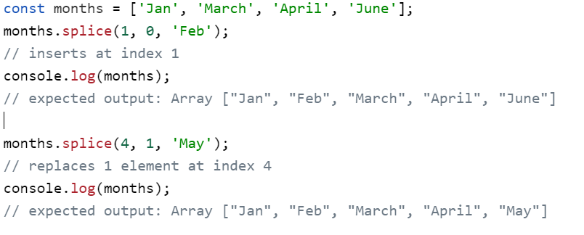
JavaScript Basics
JavaScript Arrays - looping

Slide 13
JavaScript Basics
JavaScript Arrays - looping
8) Sorting an Array
The sort() method sorts an array alphabetically.
var fruits = ["Banana", "Orange", "Apple", "Mango"];
fruits.sort(); // Sorts the elements of fruits
9) The reverse() method reverses the elements in an array.
fruits.reverse();

Slide 14
JavaScript – Built-in Objects
Array – Sort
arr.sort([compareFunction])
If compareFunction is not specified,array is sorted as strings in ascending order
Arr = [1, 2, 11, 12, 22]
Console.log(arr.sort())
// 1, 11, 12, 2, 22
compareFunction takes two parameters say a and b and returns
1 if a > b
0 if a = b
-1 if a < b
To reverse the order modify the condition for returning 1, 0 and -1
var numbers = [4, 2, 5, 1, 3]; numbers.sort(function(a, b) { return b - a; });
console.log(numbers);
// [5,4,3,2,1]

Slide 15
Array.sort- Compare function
compareFunction(Optional): A function that defines an alternative sort order. The function should return a negative, zero, or positive value, depending on the arguments, like:
function(a, b)
{return a-b}
When the sort() method compares two values, it sends the values to the compare function, and sorts the values according to the returned (negative, zero, positive) value.
Example:
When comparing 40 and 100, the sort() method calls the compare function(40,100).
The function calculates 40-100, and returns -60 (a negative value).
The sort function will sort 40 as a value lower than 100.

Slide 16
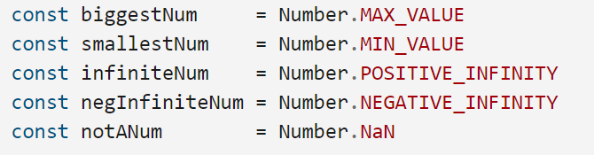
JavaScript – Built-in Objects
Number
Properties
• MAX_VALUE : represents the maximum numeric value representable in JavaScript.
• MIN_VALUE
• NaN – Not a Number
• POSITIVE_INFINITY
• NEGATIVE_INFINITY
• Operations resulting in errors return NaN
• Use isNaN(a) to test if a is NaN
• toString method converts a number to string
Notes:
Touch

Slide 17
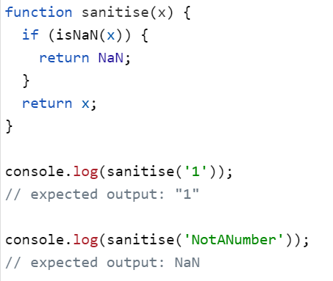
JavaScript – Built-in Objects
NaN- Not a Number
Notes:
Refer notes for details on all methods

Slide 18
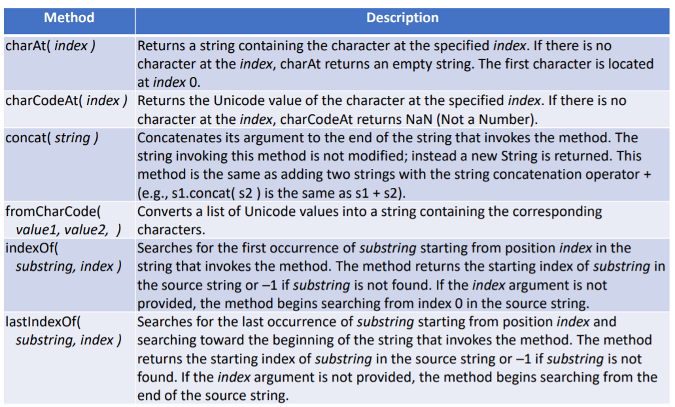
JavaScript – Built-in Objects
String Object
Notes:
Touch

Slide 19
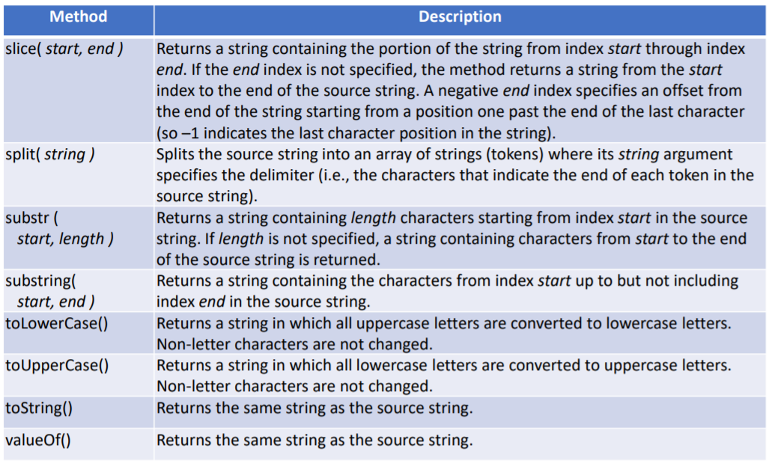
JavaScript – Built-in Objects
String Object
Notes:
Touch

Slide 20
JavaScript – Built-in Objects
Date Methods
var now= new Date();
This creates a Date object for the time at which it was created (stored as the number of milliseconds since January 1, 1970, UTC - Epoch)
toLocaleString | A string of the Date information
(get/set)Date | The day of the month
(get/set)Month | The month in the range of 0 to 11
(get/set)Day | The day of the week in the range of 0 to 6
(get/set)FullYear | The year
(get/set)Time | The number of milliseconds since January 1, 1970
(get/set)Hours | The number of the hour in the range of 0 to 23
(get/set)Minutes | The number of the minute in the range of 0 to 59
(get/set)Seconds | The number of the second in the range of 0 to 59
(get/set)Milliseconds | The number of the millisecond in the range of 0 to 999
Notes:
Refer notes for details on all methods

Slide 21
JavaScript – Built-in Objects
Math Methods
Provides static mathematical constants and functions
Math.E | Euler’s Constant (Approx. 2.718)
Math.PI | Value of PI (Approx. 3.1416)
Math.SQRT2 | Square root of 2 (Approx. 1.414)
Math.abs(x) | Returns the absolute value of x
Math.ceil(x) | Returns the smallest integer greater than or equal to x
Math.floor(x) | Returns the largest integer less than or equal to x.
Math.max([x[, y[, …]]]) | Returns the largest of zero or more numbers.
Math.min([x[, y[, …]]]) | Returns the smallest of zero or more numbers.
Math.pow(x, y) | Returns base x to the exponent power y (that is, x^{y}).
Math.random() | Returns a pseudo-random number between 0 and 1.
Notes:
Refer notes for details on all methods
To generate a random number between a and b
rand=a+Math.floor(Math.random()*(b-a))

Slide 22
JavaScript – Built-in Objects
Window – Properties and Methods
Global object containing global variables and functions declared in the page. For example, var x; can also be accessed as window.x
location | object containing location details like href, path etc.
history | object containing the browser history
localStorage | object containing a local cache for storing user info
innerHeight, innerWidth | dimensions of the display area of the browser
alert(text) | method to display a dialog box with message
prompt(text,default) | method to seek input from user, returns string
confirm(text) | method to show a confirmation dialog
setInterval, clearInterval | start/stop performing action repeatedly after an interval
setTimeout, clearTimeout | start/stop performing action once after a timeout period
Notes:
Refer notes for details on all methods

Slide 23
THANK YOU
Prof.Vinay Joshi and Dr.Sarasvathi V
Department of Computer Science and Engineering

